Slide 1
SHT31 Temperature Sensor (Adafruit ESP32)

Slide 2
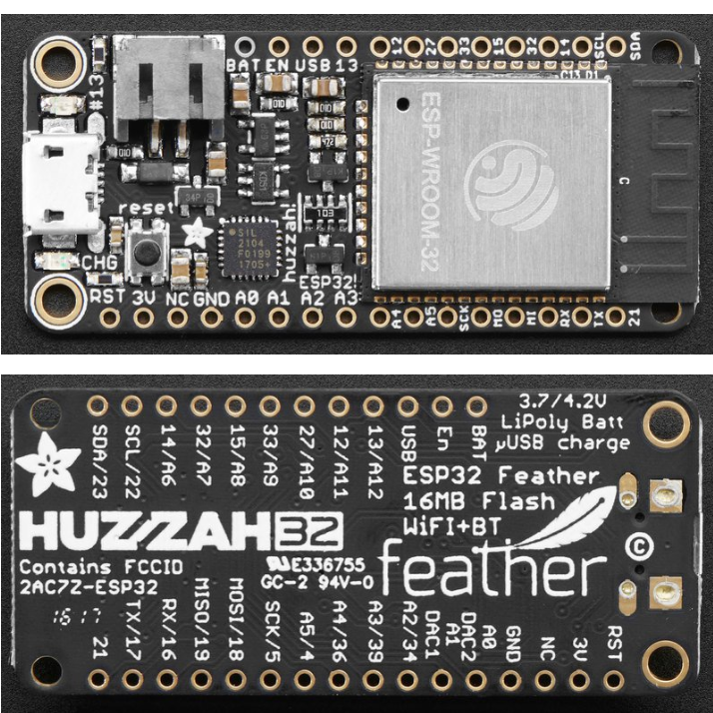

Slide 3
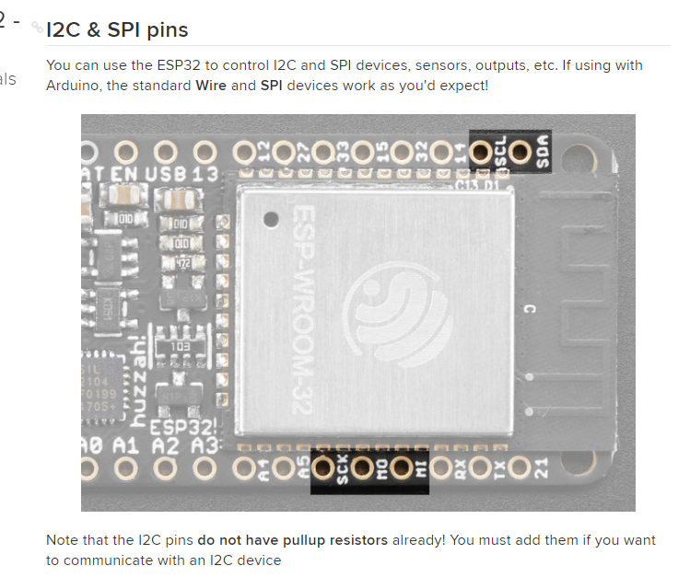
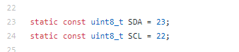
Pin Location

Slide 4
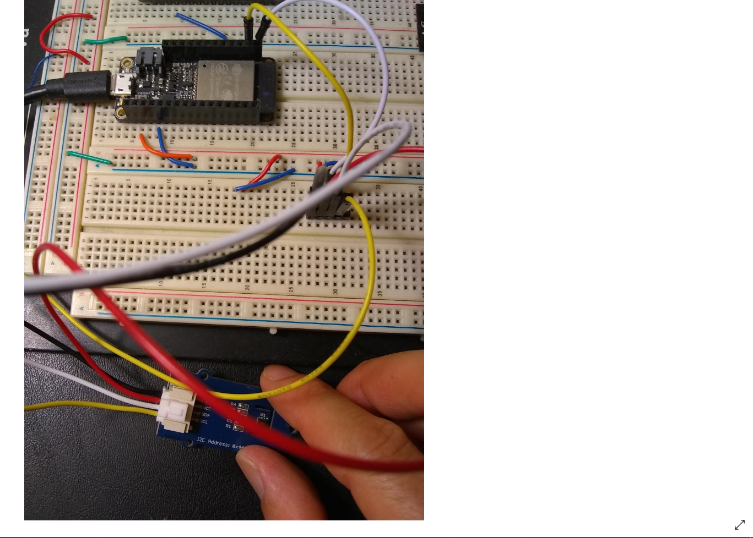
SDA (white), SCL (yellow), VCC (3V), GND(0)

Slide 5
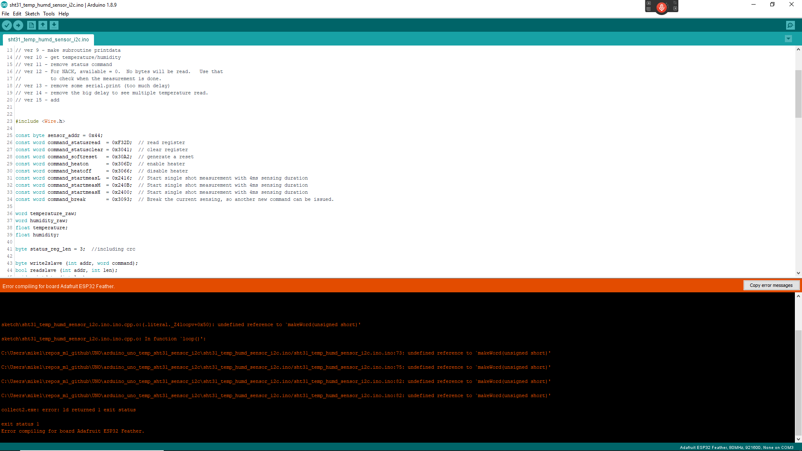
Error (No support for word)

Slide 6
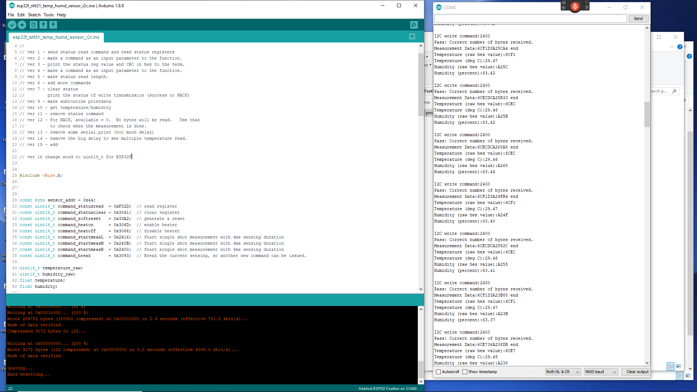
Output Code (only change : word → uint16_t)

